Slide 1
CSE477
VLSI Digital Circuits
Fall 2002
Lecture 22: Shifters, Decoders, Muxes
Mary Jane Irwin ( www.cse.psu.edu/~mji ) www.cse.psu.edu/~cg477
[Adapted from Rabaey’s Digital Integrated Circuits, ©2002, J. Rabaey et al.]

Slide 2
Review: Basic Building Blocks
Datapath
  Execution units
    Adder, multiplier, divider, shifter, etc.
  Register file and pipeline registers
  Multiplexers, decoders
Control
  Finite state machines (PLA, ROM, random logic)
Interconnect
  Switches, arbiters, buses
Memory
  Caches (SRAMs), TLBs, DRAMs, buffers

Slide 3
Parallel Programmable Shifters
Shift amount
Shift direction
Shift type (logical,
arith, circular)
Control =
Data Out
Data In
Shifters used in multipliers, floating point units
Consume lots of area if done in random logic gates
Notes:
Shifting a data word left or right over a constant amount is a trivial hardware operation and is implemented by the appropriate signal wiring

Slide 4
A Programmable Binary Shifter
rgt
nop
left
A_{i}
A_{i} | A_{i-1} | rgt | nop | left | B_{i} | B_{i-1}
A₁ | A₀ | 0 | 1 | 0 | A₁ | A₀
A₁ | A₀ | 1 | 0 | 0 | 0 | A₁
A₁ | A₀ | 0 | 0 | 1 | A₀ | 0
B_{i}
A_{i-1}
B_{i-1}
Notes:
For class handout

Slide 5
A Programmable Binary Shifter
rgt
nop
left
A_{i}
A_{i} | A_{i-1} | rgt | nop | left | B_{i} | B_{i-1}
A₁ | A₀ | 0 | 1 | 0 | A₁ | A₀
A₁ | A₀ | 1 | 0 | 0 | 0 | A₁
A₁ | A₀ | 0 | 0 | 1 | A₀ | 0
B_{i}
A_{i-1}
B_{i-1}
Notes:
For lecture

Slide 6
4-bit Barrel Shifter
Example: Sh0 = 1
B₃B₂B₁B₀ = A₃A₂A₁A₀
Sh1 = 1
B₃B₂B₁B₀ = A₃A₃A₂A₁
Sh2 = 1
B₃B₂B₁B₀ = A₃A₃A₃A₂
Sh3 = 1
B₃B₂B₁B₀ = A₃A₃A₃A₃
A₃
B₃
Sh1
A₂
B₂
Sh2
A₁
B₁
Sh3
A₀
B₀
Area dominated by wiring
Sh0
Sh1
Sh2
Sh3
Notes:
For class handout

Slide 7
4-bit Barrel Shifter
Example: Sh0 = 1
B₃B₂B₁B₀ = A₃A₂A₁A₀
Sh1 = 1
B₃B₂B₁B₀ = A₃A₃A₂A₁
Sh2 = 1
B₃B₂B₁B₀ = A₃A₃A₃A₂
Sh3 = 1
B₃B₂B₁B₀ = A₃A₃A₃A₃
A₃
B₃
Sh1
A₂
B₂
Sh2
A₁
B₁
Sh3
A₀
B₀
Area dominated by wiring
Sh0
Sh1
Sh2
Sh3
Notes:
For lecture
Number of rows equals the word length of the data and the number of columns equals the maximum shift width. The control wires are routed diagonally through the array. Implementation does sign extend – so arithmetic shift.
Note that signal goes through at most one fet (so constant propagation delay (in theory))
Also note, that the capacitance of the output wires goes linearly with the shift width (linear grow in fet diffusion capacitance). But note the N**2 increase in diff cap load on the input data lines (for circular shifter)
Size of cell bounded by the pitch of the metal wires.
Also not the n! diffusion capacitances on the input lines
Need shift control (encoded) count decoded into shift signals since it needs a control wire for every shift bit. Since count is normally provided in an encoded form, also need to have a decoder..

Slide 8
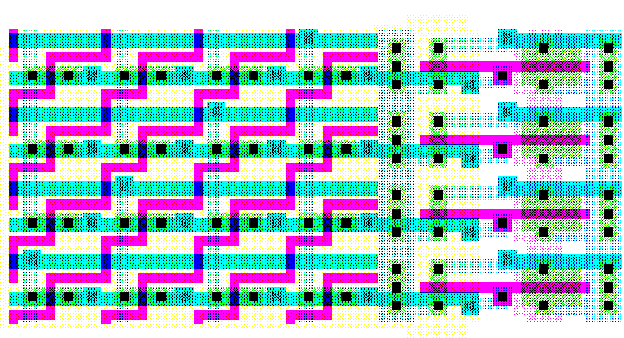
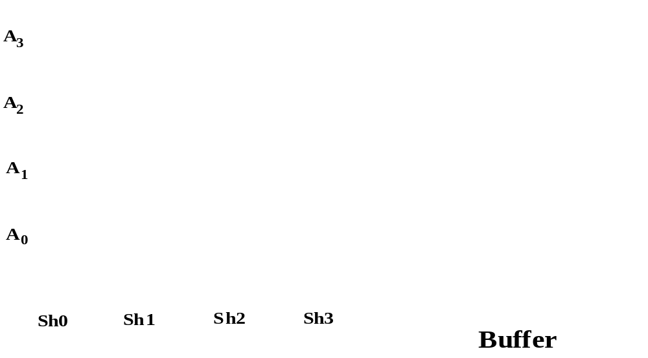
4-bit Barrel Shifter Layout
Width_{barrel}
Only one Sh#
active at a time_{l}
Width_{barrel} ~ 2 p_{m} N
N = max shift distance, p_{m} = metal pitch
Delay ~ 1 fet + N diff caps

Slide 9
8-bit Logarithmic Shifter
Sh1
!Sh1
Sh2
!Sh2
Sh3
!Sh3
A₃
B₃
A₂
B₂
A₁
B₁
A₀
B₀
Notes:
For class handout

Slide 10
8-bit Logarithmic Shifter
0
1
1
0
0
1
Sh1
!Sh1
Sh2
!Sh2
Sh3
!Sh3
A₃
B₃
A₂
B₂
A₁
B₁
A₀
B₀
log N stages
Notes:
For lecture
Total shift is decomposed into shifts over powers of two. A shifter of width of N consists of log2N stages where the ith stage either shifts over 2^i or passes the data unchanged.
Note that the control bits are encoded – thus we don’t need a decoder for the shift count (as in the previous shifter).
The speed depends on the shift width in a logarithmic way – and

Slide 11
8-bit Logarithmic Shifter Layout Slice
1
2
4
A₃
B₃
A₂
B₂
A₁
B₁
A₀
B₀
Width_{log} ~ p_{m}(2K+(1+2+…+2^{K-1})) = p_{m}(2^{K}+2K-1)
K = log₂ N
Delay ~ K fets + 2 diff caps
Notes:
Notice regularity of layout
M K 2**K
1 0 1
2 1 2
4 2 4
8 3 8
16 4 16

Slide 12
Shifter Implementation Comparisons
N | K | Barrel |  | Logarithmic
 |  | Width | Speed | Width | Speed
 |  | 2 N p_{m} | 1 + N diffs | p_{m}(2^{K}+2K-1) | K + 2 diffs
8 | 3 | 16 p_{m} | 1 + 8 | 13 p_{m} | 3 + 2
16 | 4 | 32 p_{m} | 1 + 16 | 23 p_{m} | 4 + 2
32 | 5 | 64 p_{m} | 1 + 32 | 41 p_{m} | 5 + 2
64 | 6 | 128 p_{m} | 1 + 64 | 75 p_{m} | 6 + 2
Notes:
So the barrel shifter is better for small shifters (faster, not much bigger) and the log shifter is preferred for larger shifters both due to size and delay.
Log shifters are always smaller. For larger shifter may have to start worrying about the number of pass transistors in series.

Slide 13
Decoders
Decodes inputs to activate one of many outputs
  two inverters, four 2-input nand gates, four inverters plus enable logic
  how about for a 3-to-8, 4-to-16, etc. decoder?
Enable
Out₀ = !In₁ & !In₀
In₀
Out₁ = !In₁ & In₀
2x4
In₁
Out₂ = In₁ & !In₀
Out₃ = In₁ & In₀
Notes:
Think about how you would implement it in random logic – 2 inverters, four and gates (plus enable logic additions)

Slide 14
Dynamic NOR Decoder
V_{dd}
GND
GND
B₃
B₂
B₁
B₀
A₀
!A₀
A₁
!A₁
precharge
Notes:
Slide for class handout.

Slide 15
Dynamic NOR Decoder
V_{dd}
GND
GND
on on
on
on
B₃
1
1
1
1
→ 0
→ 0
→ 0
→ 1
B₂
B₁
B₀
A₀
!A₀
A₁
!A₁
precharge
0 →1
0 1 0 1
Notes:
Slide for lecture.
Dynamic 2-to-4 NOR decoder – precharge all outputs high, then GND inactive outputs - active “high” output signals
Note that signal goes through at most one fet (so constant propagation delay (in theory)) – some output wires have two parallel paths to GND
Also note, that the capacitance of the output wires goes linearly with the decoder size (linear grow in fet diffusion capacitance)

Slide 16
Dynamic NAND Decoder
GND
B₃
B₂
B₁
B₀
A₀
!A₀
A₁
!A₁
precharge
Notes:
For class handout

Slide 17
Dynamic NAND Decoder
GND
B₃
1
1
1
1
→ 1
→ 1
→ 1
→ 0
B₂
B₁
on
on
B₀
A₀
!A₀
A₁
!A₁
precharge
0 1 0 1
0 →1
Notes:
For lecture.
Dynamic 2-to-4 NAND decoder – precharge all outputs high, then discharge active output - active “low” output signals
Must ensure that all input signals are low during precharge – else Vdd and GND connected!
Note that the number of fets goes linearly with the decoder size – 2-to-4 has two fets in series, 3-to-8 has 3 fets in series, etc.- so will be slower than the NOR implementation if the gate capacitance dominates diffusion capacitance

Slide 18
Building Big Decoders from Small
Active low enable Active low output
1 → 0 → 1
2x4
enable
2x4
. . .
1x2
2x4
2x4
A₄
A₃
A₂
A₁
A₀
0 0 0 0 1
Notes:
Will need to catch the output that goes to zero before it precharges again

Slide 19
Multiplexers
Selects one of several inputs to gate to the single output
  two inverters, four 3-input nands, one 4-input nand
  how about for an 8x1, 16x1, etc. mux?
S₁ S₀
In₀
In₁
4x1
Out = In₀ & !S₁ & !S₀ |
In₁ & !S₁ & S₀ |
In₂ & S₁ & !S₀ |
In₃ & S₁ & S₀
In₂
In₃

Slide 20
Review: TG 2x1 Multiplexer
S
S
F
S
V_{DD}
In₂
!S
F
In₁
S
F = !((In₁ & S) | (In₂ & !S))
GND
In₁
S
S
In₂
Notes:
How does this compare to a static complementary multiplexer (4t in pull down, 4t in pull up), so 2 fewer transistors.
Smaller - probably
Faster?
Cooler?

Slide 21
Building Big Muxes from Small
S₀
S₁
A₀
2x1
A₁
2x1
Out
A₂
2x1
A₃
Notes:
For class handout

Slide 22
Building Big Muxes from Small
0
1
S₀
S₁
A₀
2x1
A₁
2x1
Out
A₂
2x1
A₃
Notes:
For lecture

Slide 23
Review: Datapath Bit-Sliced Organization
Control Flow
Bit 3
Bit 2
From I$
Pipeline Register
Multiplexer
Register File
Pipeline Register
Multiplexer
Adder
Shifter
Pipeline Register
Pipeline Register
Bit 1
Bit 0
decoder
Data Flow
To/From D$
Tile identical bit-slice elements

Slide 24
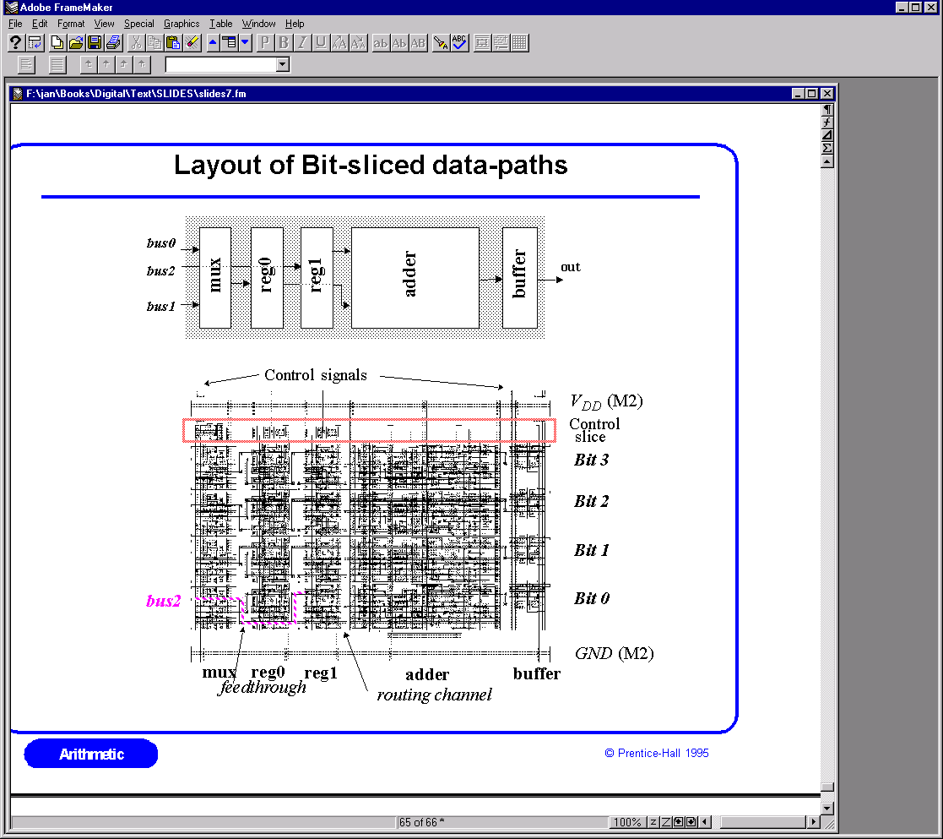
Layout of Bit-Sliced Datapaths
Notes:
Must dimension Vdd and GND lines to carry peak current required
Must provide enough driving capacity on control signals to handle a potentially large fan-out on the control lines
Vertical and horizontal routing channel give more compact layouts (some may prevent well sharing)
Horizontal feed throughs (signal needed in a cell downstream but not in the immediate neighboring cell) - if don’t make room for misc. feed throughs, will have to route around the cells, leading to longer wires and bigger layouts

Slide 25
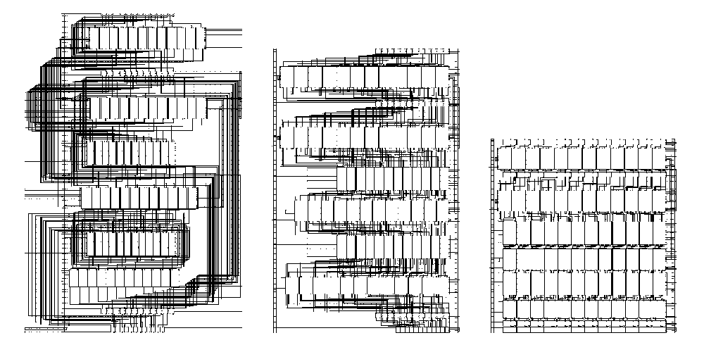
Layout of Bit-sliced Datapaths
Without feedthroughs or pitch matching (4.2μm²)
With feedthroughs (3.2μm²)
With feedthroughs and pitch matching (2.2μm²)

Slide 26
Alpha 21264 Integer Unit Datapath
RC1_1
RC1_0
Multimedia engine
Shifter
bus driver
Intercluster bypass
tristate bus driver
Adder
Logic box
Register
file
decoder
Register file
Logic box
Adder
Intercluster bypass
Load bypass
Store FIFO
Address drivers
RC2_0
RC2_1
to D$
LSD_0
LSD_1
Notes:
Contains two integer execution units, GPR arrays (register file) are located inside the datapaths of the integer exec. units between the upper and lower functional units.
Consequently, the register file layout must occur on the same pitch as the datapath. The integer register file of the Alpha 21164 has six separate write ports and four read ports.

Slide 27
Next Lecture and Reminders
Next lecture
  Semiconductor memories
    Reading assignment – Rabaey, et al, 12.1-12.2.1
Reminders
  Project final reports due December 5th
  HW5 (last one!) due November 19th
  Final grading negotiations/correction (except for the final exam) must be concluded by December 10th
  Final exam scheduled
    Monday, December 16th from 10:10 to noon in 118 and 121 Thomas

